Slide 1
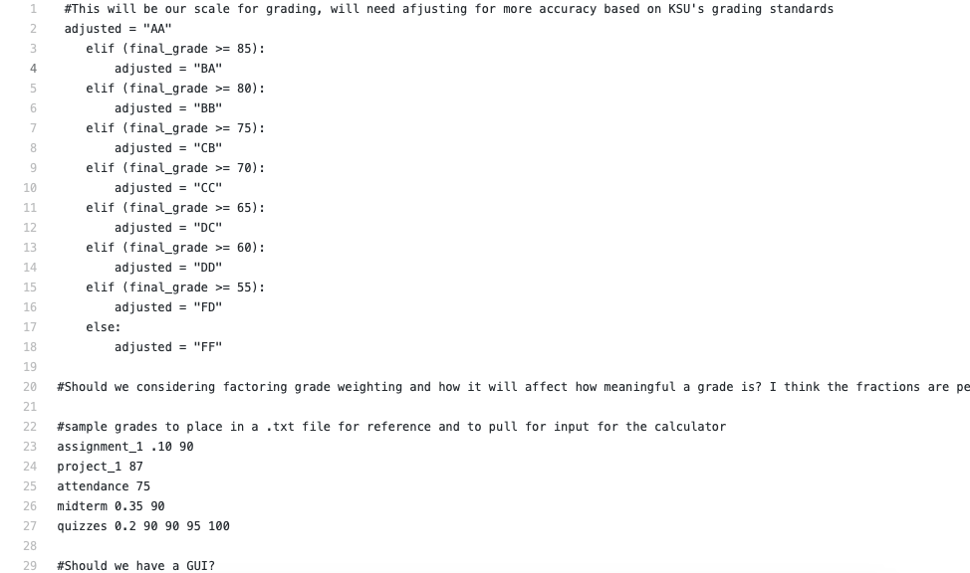
Grade Calculator
By Ryan Zimmer & Ian Wilson
Calculating your final grade for each class has never been easier than with our Grade Calculator! Stay up to date with your grades in real time! https://github.com/ksu-is/AvesGradeCalculator

